Slide 1


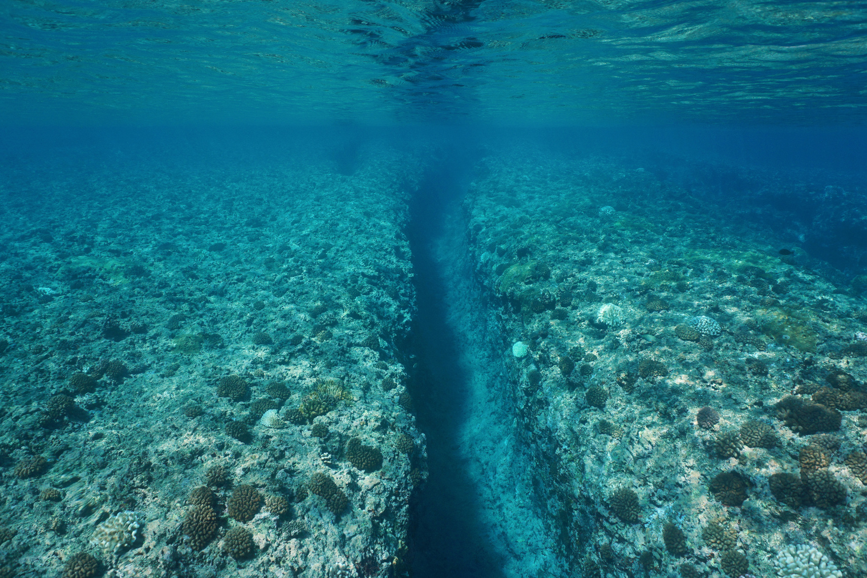

Digital Image Processing Lab
Presentation On
Underwater Image Enhancement
-by Team Pixel

Slide 2




Presented to
Professor Dr. Md. Zulfiker Mahmud
Professor
Department of Computer Science & Engineering
Jagannath University, Dhaka

Slide 3




Presented by
Team member 1
Team member 2
Farhana Akter Suci
ID: B190305001
Rifah Sajida Deya
ID: B190305004
4th Year 1st Semester
Dept. of Computer Science & Engineering
Jagannath University, Dhaka
4th Year 1st Semester
Dept. of Computer Science & Engineering
Jagannath University, Dhaka

Slide 4
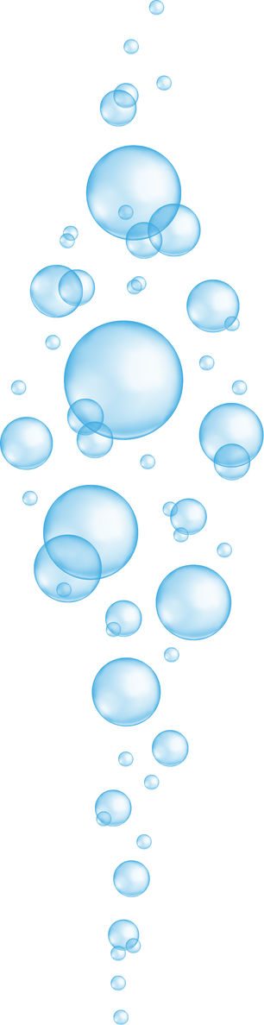
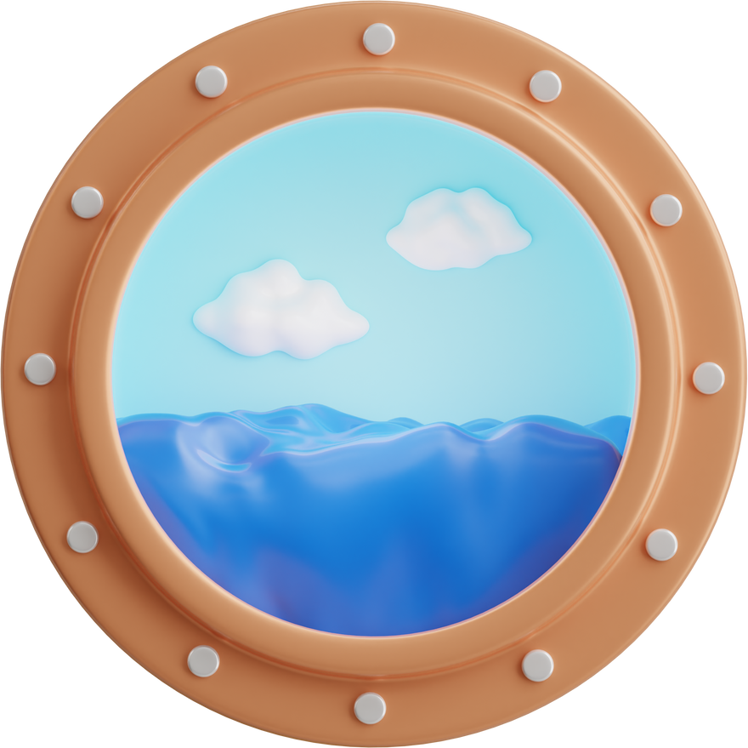
Problem Statement
Objective
Operations
Evaluation
Used Tools & Technologies
User Activity Diagram
Use Case Diagram
Implementation
Conclusion
Contents

Slide 5
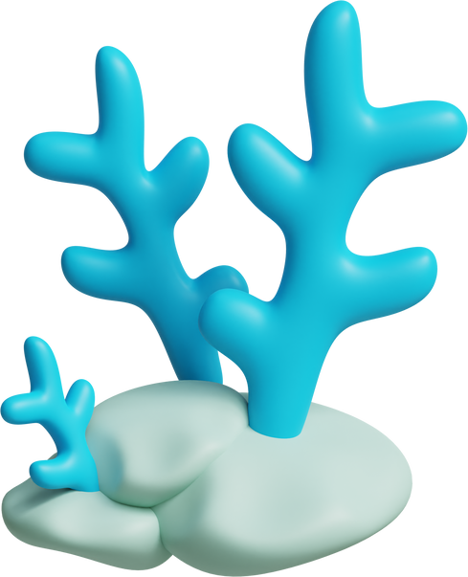
Problem Statement
Underwater images often suffer from poor visibility, low contrast, and color distortions due to the unique properties of water. As light travels through water, it is absorbed and scattered more than in air, leading to loss of colors, especially red wavelengths, and an overall bluish-green tint. Particles in the water further scatter light, causing haziness and reduced contrast.
These issues pose significant challenges for applications that rely on clear underwater imagery, such as marine biology research, underwater surveillance, archeology, and recreational diving photography.

Slide 6
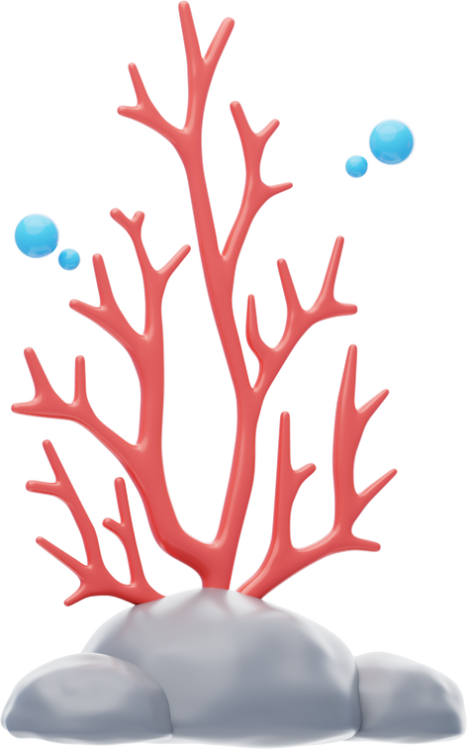
Objective
The objective of our project underwater image enhancement is to restore and improve the visual quality of underwater images by addressing color distortion, increasing contrast, and reducing haze effects.
This enhancement is essential for better analysis, feature extraction, and object recognition in underwater environments.

Slide 7

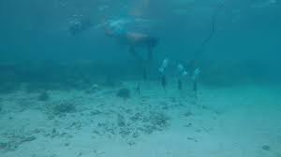
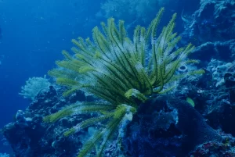
Operations
1.Noise Reduction
The first step in the process includes noise reduction by smoothing the image. Compensate image based on flag. Basically, compensating R(Red) and B(Blue) channel.
2.Color Correction
Stopwatch
Following the noise reduction step, the next step is to perform color correction separately on every color channel. Apply Gray World Algorithm to complete color correction (White balancing using Gray World Algorithm).
(Bachelor of Science)

Slide 8
3. Contrast Enhancement
The next step is to perform contrast enhancement in order to improve the visibility of objects in the image using global histogram equalization.
4.Sharpening Image
Stopwatch
(Bachelor of Science)
The next step is to perform unsharp masking to sharpen the color corrected image.

Slide 9
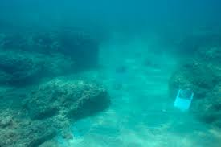
5.Fusion
Perform averaging-based fusion of sharpened image & contrast enhanced image
Perform PCA-based fusion of sharpened image & contrast enhanced image.

Slide 10
Evaluation
Here, Mean Squared Error (MSE) and Peak Signal-to-Noise Ratio (PSNR) metrics are calculated for the PCA fused and average fused images. This metrics quantify the quality of the enhancement by measuring how similar the fused images are to the reference image in terms of noise and signal strength.

Slide 11

Editor: Jupyter Notebook , Pycharm
Language: Python3
Framework: Streamlit( Python framework)
Used Tools
&
Technologies

Slide 12













User Activity Diagram
Home Page
User selected “About the App”
User selected “Underwater Image Enhancer”
About the App Page
User want to Enhance an Underwater Image
Back to Home Screen
Upload an Underwater Image
Abstract
Block Diagram
Chose if the Image is Greenish or Bluish
Get overview of the Project
See the Block Diagram
Press the Button
“Enhance Uploaded Image”
Team Members
Results of Sample Images
Get the Enhanced Image for Averaging Based Fusion and also for PCA Based Fusion
Information of the team members
View Image conversion Demo
Figure: User Activity Diagram

Slide 13

Use Case Diagram
Upload Image
Chose the uploaded Image is Greenish or Bluish
Get the Enhanced Image and Download
Figure: Use Case Diagram

Slide 14
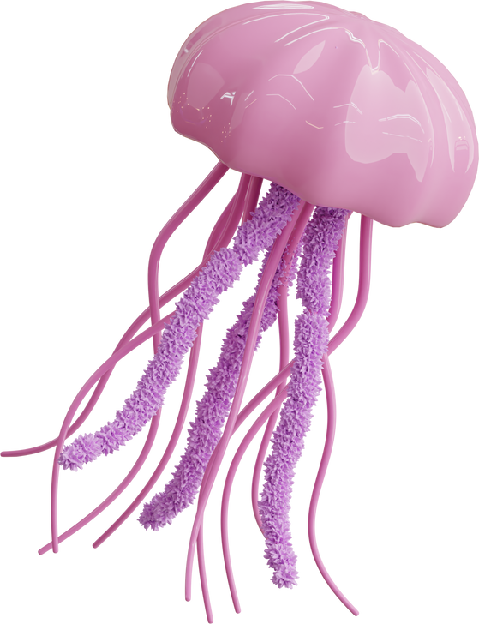
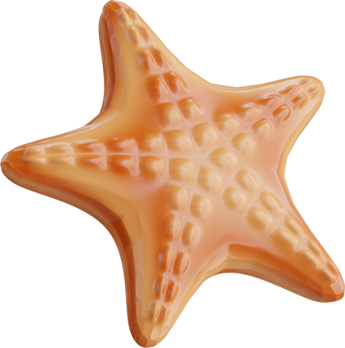

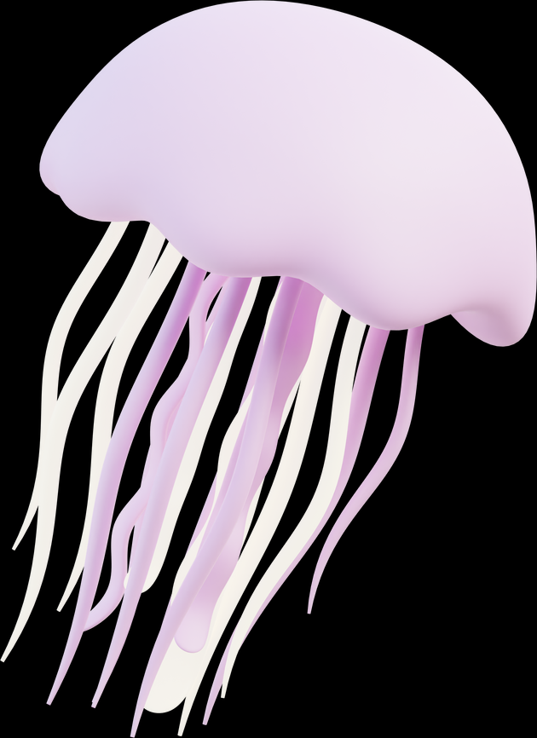
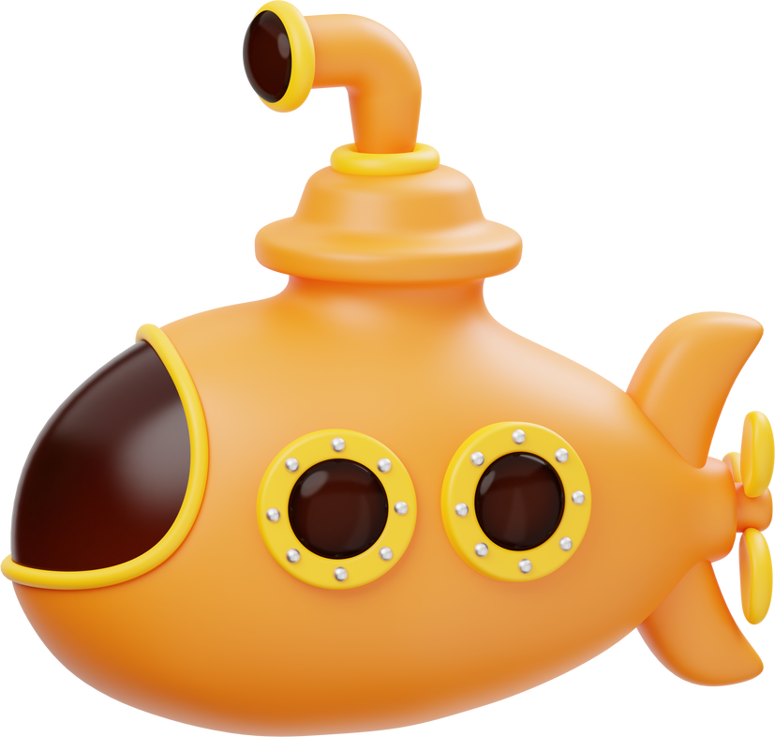
Implementation

Slide 15
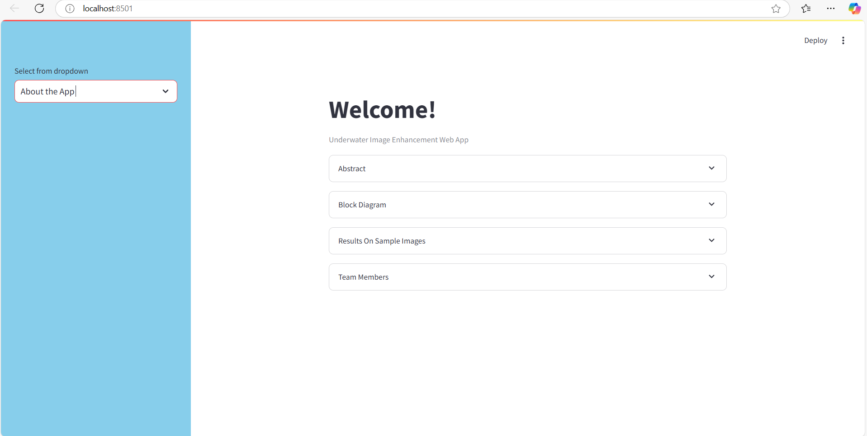

Slide 16
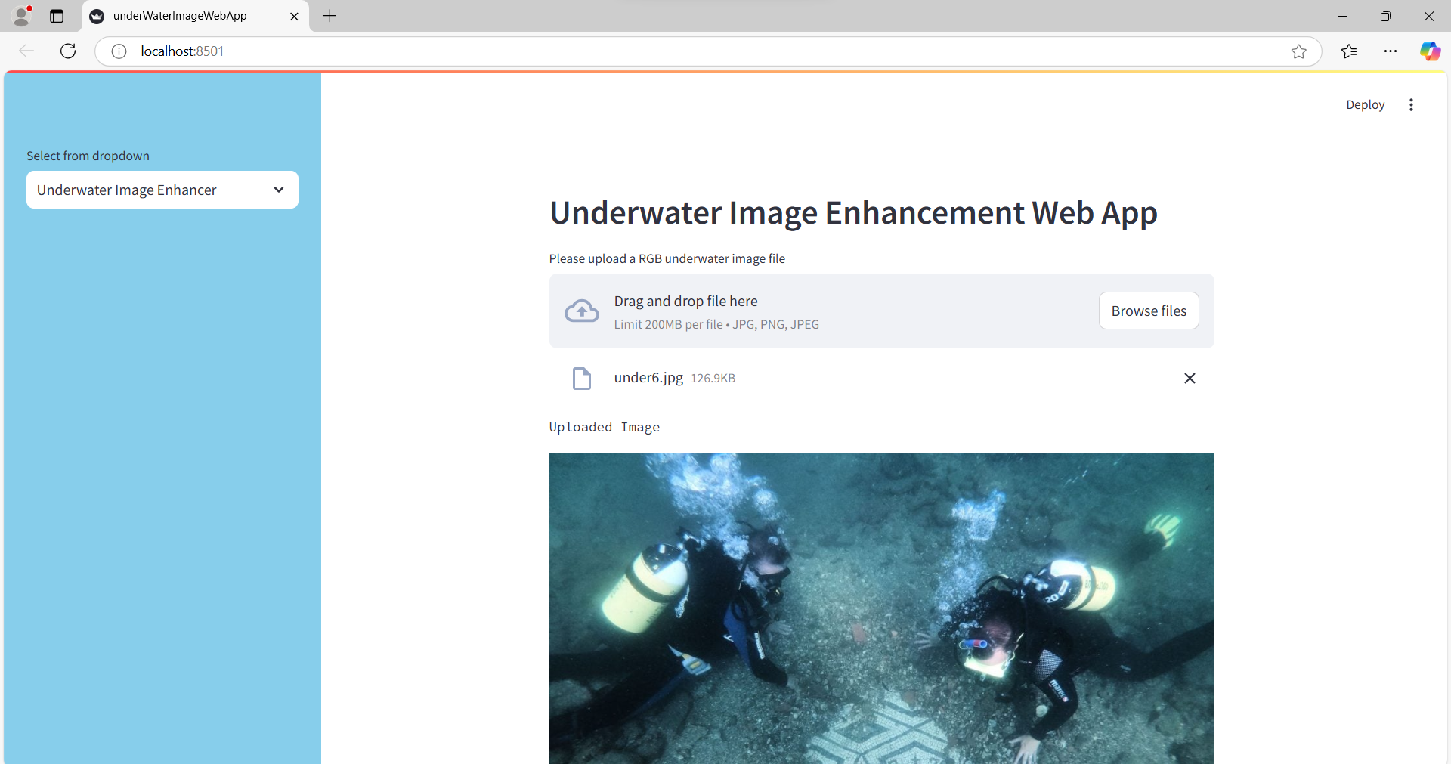

Slide 17
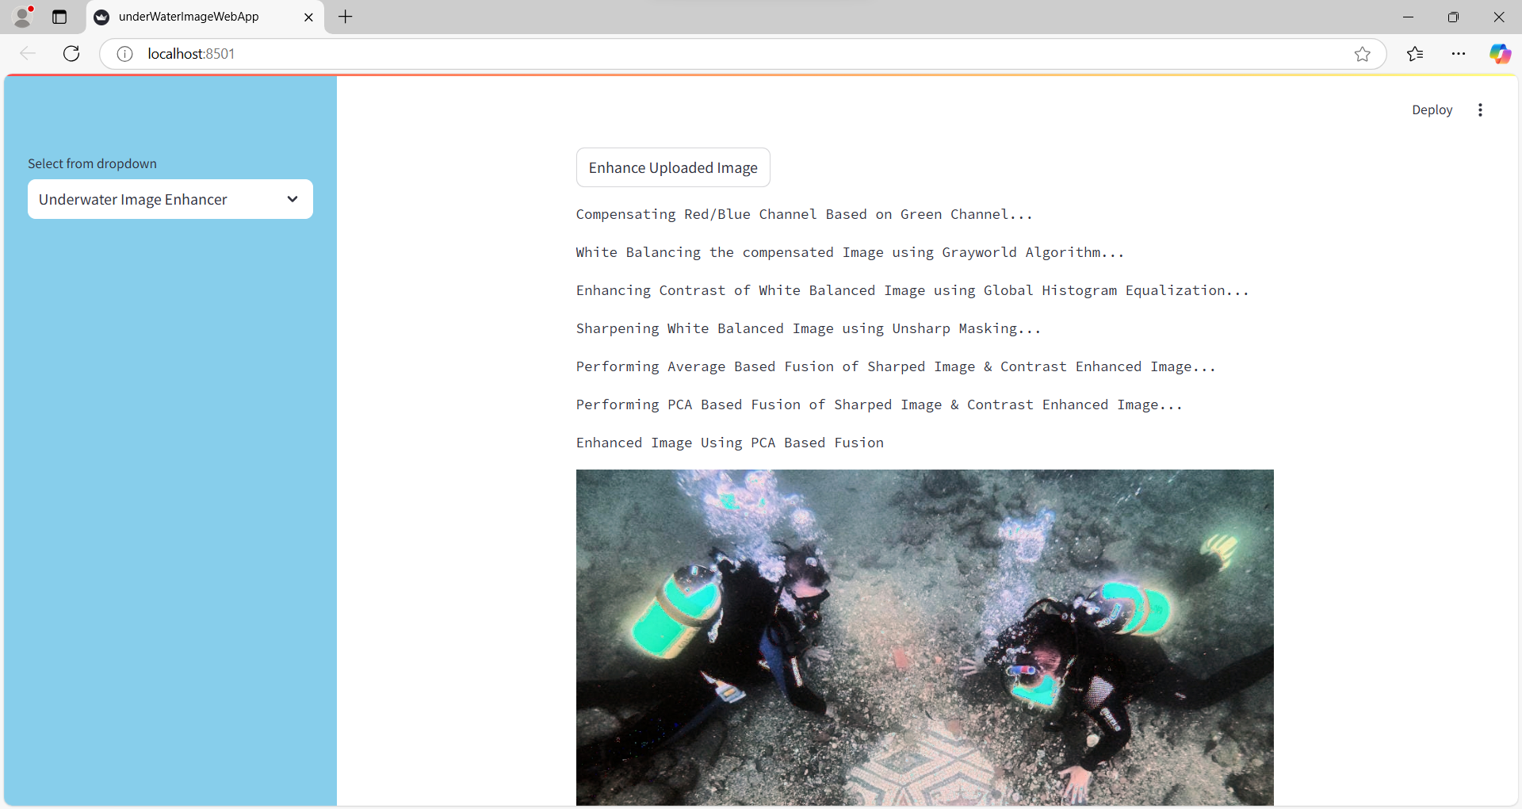

Slide 18
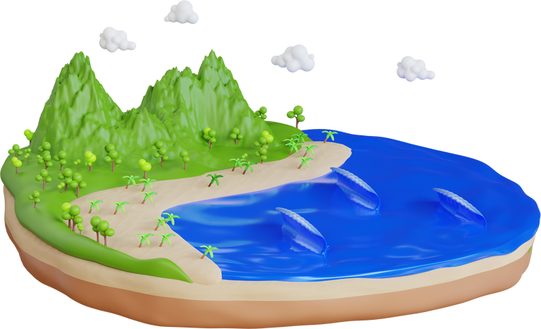
Reference
Y. Wang, W. Song, G. Fortino, L. Qi, W. Zhang and A. Liotta, "An Experimental-Based Review of Image Enhancement and Image Restoration Methods for Underwater Imaging," in IEEE Access, vol. 7, pp. 140233-140251, 2019, doi: 10.1109/ACCESS.2019.2932130.
Weidong Zhang, Lili Dong, Tong Zhang, Wenhai Xu, Enhancing underwater image via color correction and Bi-interval contrast enhancement, Signal Processing: Image Communication, Volume 90, 2021, 116030, ISSN 0923-5965, https://doi.org/10.1016/j.image.2020.116030.

Slide 19


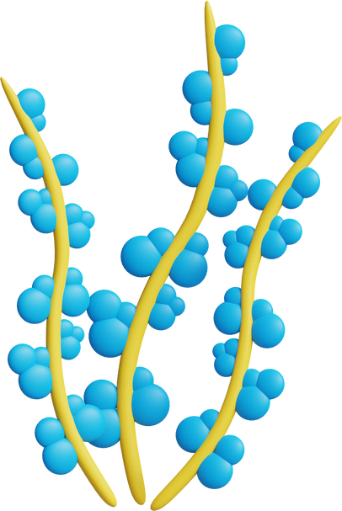
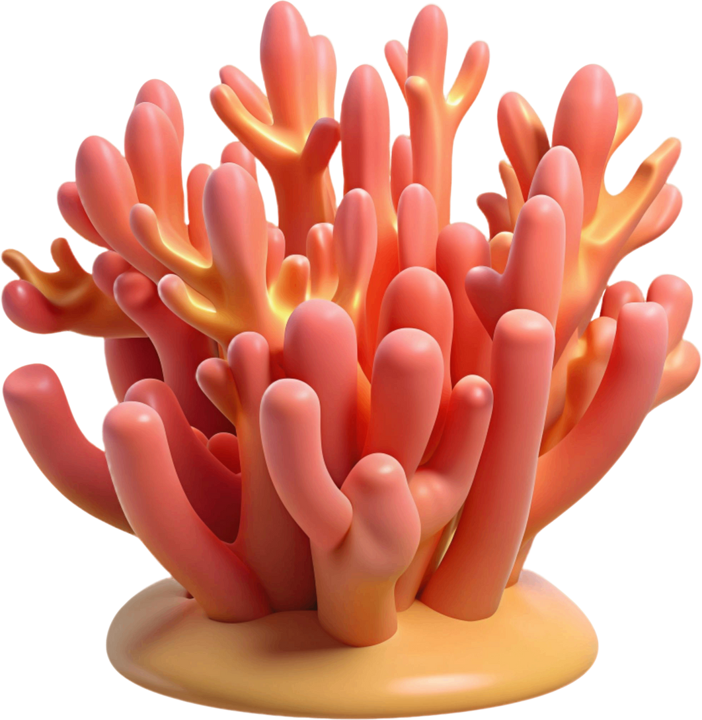
Conclusion
Our project has effectively tackled the major challenges of underwater imaging by improving color accuracy, contrast, and visibility. The process we developed significantly enhance the quality of underwater images, making them clearer and more reliable. These improvements benefit various fields such as marine biology, archaeology, and underwater robotics, demonstrating the transformative potential of our approach in enhancing underwater imaging.

Slide 20

